Slide 1


A Basic Introduction to Machine Learning
and Data Analytics
http://www.datascience4all.org
Introduction to Computational Thinking and Data Science
Yolanda Gil
University of Southern California
gil@isi.edu
CC-BY
Attribution
ACI-1355475
Last Updated:
September 2016

Slide 2
Intended Audience
Designed for students with no programming background who want to have literacy in data and computing to better approach data science projects
Computational thinking: a new way to approach problems through computing
Abstraction, decomposition, modularity,…
Data science: a cross-disciplinary approach to solving data-rich problems
Machine learning, large-scale computing, semantic metadata, workflows,…

Slide 3

These materials are released under a CC-BY License
https://creativecommons.org/licenses/by/2.0/
You are free to:
Share — copy and redistribute the material in any medium or format
Adapt — remix, transform, and build upon the material
for any purpose, even commercially.
The licensor cannot revoke these freedoms as long as you follow the license terms.
Under the following terms:
Attribution — You must give appropriate credit, provide a link to the license,
and indicate if changes were made. You may do so in any reasonable manner,
but not in any way that suggests the licensor endorses you or your use.
Artwork taken from other sources is acknowledged where it appears.
Artwork that is not acknowledged is by the author.
Please credit as: Gil, Yolanda (Ed.) Introduction to Computational Thinking and Data Science. Available from http://www.datascience4all.org
If you use an individual slide, please place the following at the bottom: “Credit: http://www.datascience4all.org/”
As editors of these materials, we welcome your feedback and contributions.

Slide 4
Acknowledgments
ACI-1355475
These course training materials were originally developed and edited by Yolanda Gil (USC) with support from the National Science Foundation with award ACI-1355475
They are made available as part of http://www.datascience4all.org
The course materials benefitted from feedback from many students at USC and student interns, particularly Taylor Alarcon (Brown University), Alyssa Deng (Carnegie Mellon University), and Kate Musen (Swarthmore College)
We welcome new contributions and suggestions

Slide 5
Introdcuction to Machine Learning and Data Analytics: Topics Covered
Machine learning and data analysis tasks
Classification
Classification tasks
Building a classifier
Evaluating a classifier
Pattern learning and clustering
Pattern detection
Pattern learning and pattern discovery
Clustering
K-means clustering
Causal discovery
Correlation
Causation
Causal models
Bayesian networks
Markov networks
Simulation and modeling
Practical use of machine learning and data analysis

Slide 6
PART I: Machine Learning and Data Analysis Tasks

Slide 7
Different Data Analysis Tasks
Classification
Assign a category (ie, a class) for a new instance
Clustering
Form clusters (ie, groups) with a set of instances
Pattern detection
Identify regularities (ie, patterns) in temporal or spatial data
Simulation
Define mathematical formulas that can generate data similar to observations collected

Slide 8
Different Data Analysis Tasks
Classification
Clustering
Pattern detection
Causal discovery
Simulation
…
Each type of task is characterized by the kinds of data they require and the kinds of output they generate
Each type of task uses different algorithms

Slide 9
Learning Approaches
Supervised Learning
Unsupervised Learning
The training data is annotated with information to help the learning system
The training data is not annotated with any extra information to help the learning system
Semi-Supervised Learning

Slide 10
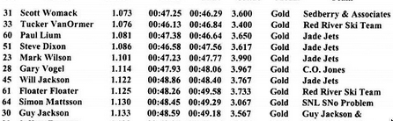
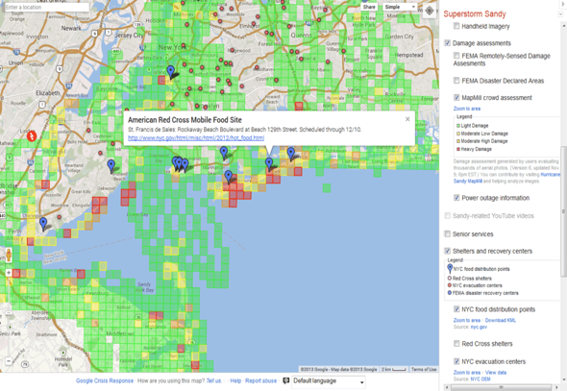
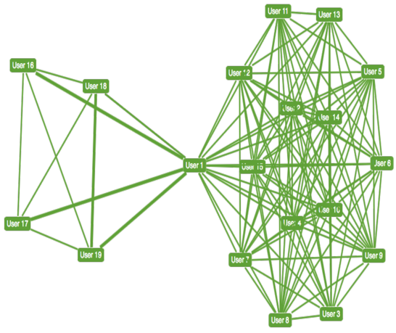
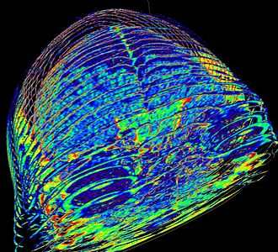
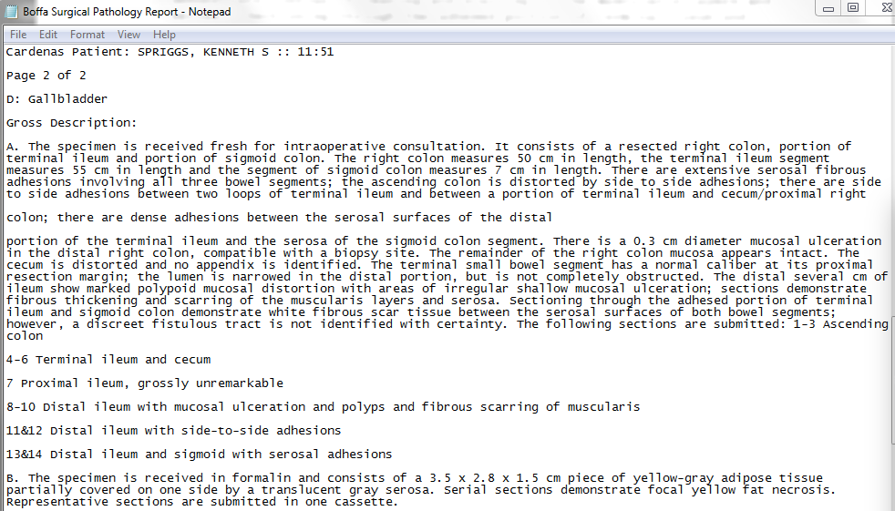
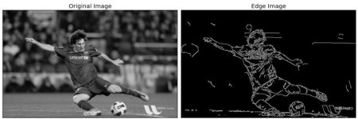
General Approaches are Adapted to Specific Kinds of Data

Slide 11
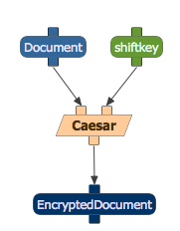
datascience4all Treat Programs as “Black Boxes”
You don’t have to understand complex mathematics and programming in order to use software
This is why we often refer to software as a “black box”
You only need to understand inputs and outputs and the program’s function in order to use it correctly

Slide 12
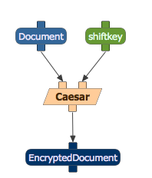
datascience4all Programs as Functions: Inputs, Outputs, and Parameters
Shift key: 5
Original: HELLO
Cipher: KHOOR

Slide 13
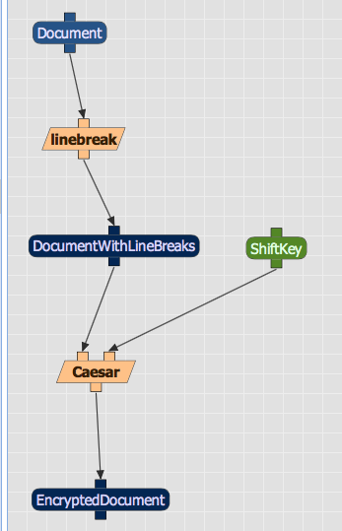
datascience4all: Basic Background Workflow as a Composition of Functions

Slide 14
PART II: Classification

Slide 15
Part II: Classification Topics
Classification tasks
Building a classifier
Evaluating a classifier

Slide 16

Classifying Mushrooms
What mushrooms are edible, i.e., not poisonous?
Book lists many kinds of mushrooms identified as either edible, poisonous, or unknown edibility
Given a new kind mushroom not listed in the book, is it edible?
https://archive.ics.uci.edu/ml/datasets/Mushroom

Slide 17
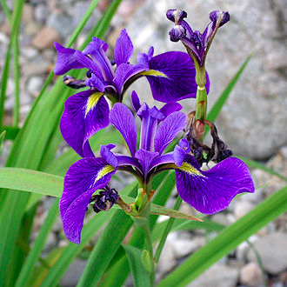
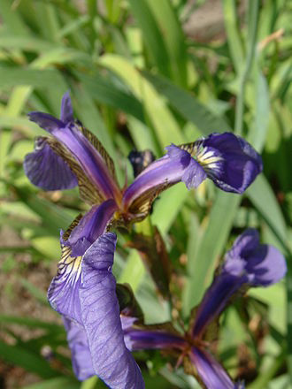
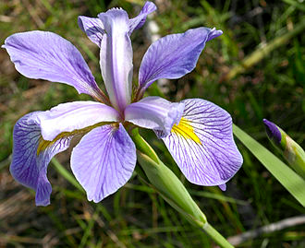
Classifying Iris Plants
Iris flowers have different sepal and petal shapes:
Iris Setosa
Iris Versicolour
Iris Virginica
Suppose you are shown lots of examples of each type. Given a new iris flower, what type is it?
https://en.wikipedia.org/wiki/Iris_setosa
https://en.wikipedia.org/wiki/Iris_versicolor
https://en.wikipedia.org/wiki/Iris_virginica

Slide 18
1. Classification Tasks

Slide 19
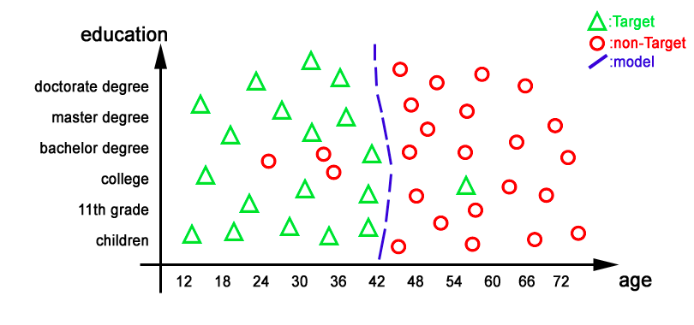
Classification Tasks
Given:
A set of classes
Instances (examples) of each class
Generate: A method (aka model) that when given a new instance it will determine its class
http://www.business-insight.com/html/intelligence/bi_overfitting.html

Slide 20
Classification Tasks
Given:
A set of classes
Instances of each class
Generate: A method that when given a new instance it will determine its class
Instances are described as a set of features or attributes and their values
The class that the instance belongs to is also called its “label”
Input is a set of “labeled instances”

Slide 21
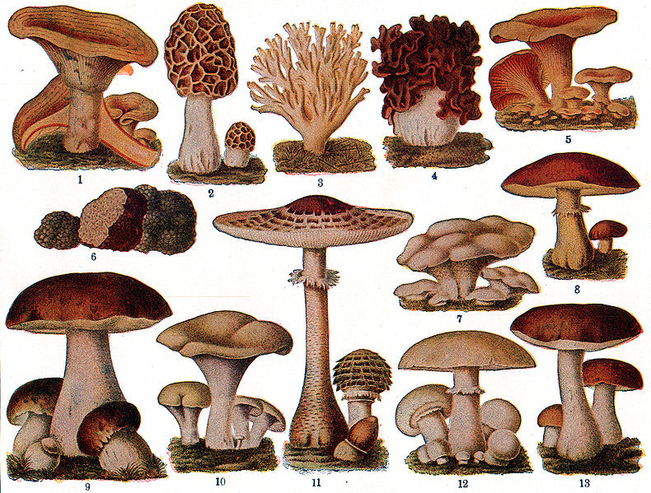
Possible Features
1. cap-shape: bell=b,conical=c,convex=x,flat=f, knobbed=k,sunken=s 2. cap-surface: fibrous=f,grooves=g,scaly=y,smooth=s 3. cap-color: brown=n,buff=b,cinnamon=c,gray=g,green=r, pink=p,purple=u,red=e,white=w,yellow=y 4. bruises?: bruises=t,no=f 5. odor: almond=a,anise=l,creosote=c,fishy=y,foul=f, musty=m,none=n,pungent=p,spicy=s 6. gill-attachment: attached=a,descending=d,free=f,notched=n 7. gill-spacing: close=c,crowded=w,distant=d 8. gill-size: broad=b,narrow=n 9. gill-color: black=k,brown=n,buff=b,chocolate=h,gray=g, green=r,orange=o,pink=p,purple=u,red=e, white=w,yellow=y 10. stalk-shape: enlarging=e,tapering=t 11. stalk-root: bulbous=b,club=c,cup=u,equal=e, rhizomorphs=z,rooted=r,missing=? 12. stalk-surface-above-ring: fibrous=f,scaly=y,silky=k,smooth=s 13. stalk-surface-below-ring: fibrous=f,scaly=y,silky=k,smooth=s 14. stalk-color-above-ring: brown=n,buff=b,cinnamon=c,gray=g,orange=o, pink=p,red=e,white=w,yellow=y 15. stalk-color-below-ring: brown=n,buff=b,cinnamon=c,gray=g,orange=o, pink=p,red=e,white=w,yellow=y 16. veil-type: partial=p,universal=u 17. veil-color: brown=n,orange=o,white=w,yellow=y 18. ring-number: none=n,one=o,two=t 19. ring-type: cobwebby=c,evanescent=e,flaring=f,large=l, none=n,pendant=p,sheathing=s,zone=z 20. spore-print-color: black=k,brown=n,buff=b,chocolate=h,green=r, orange=o,purple=u,white=w,yellow=y 21. population: abundant=a,clustered=c,numerous=n, scattered=s,several=v,solitary=y 22. habitat: grasses=g,leaves=l,meadows=m,paths=p, urban=u,waste=w,woods=d
https://commons.wikimedia.org/wiki/File:Twelve_edible_mushrooms_of_the_United_States.jpg

Slide 22
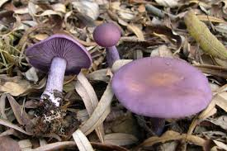
Describing an Instance
p,x,s,n,t,p,f,c,n,k,e,e,s,s,w,w,p,w,o,p,k,s,u
Class: poisonous - p
Cap shape: convex – x
Cap surface: smooth – s
Cap color: brown – n
Bruises: true – t
Odor: pungent – p
…
https://en.wikipedia.org/wiki/Edible_mushroom#/media/File:Lepista_nuda.jpg

Slide 23
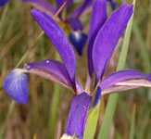
Iris Classification: “Continuous” Feature Values
1. sepal length in cm 2. sepal width in cm 3. petal length in cm 4. petal width in cm 5. class: -- Iris Setosa -- Iris Versicolour -- Iris Virginica

Slide 24
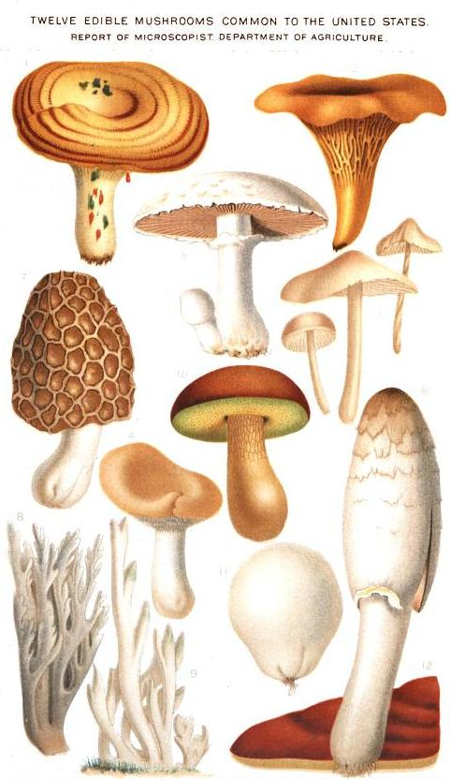
Describing Many Instances
p,x,s,n,t,p,f,c,n,k,e,e,s,s,w,w,p,w,o,p,k,s,u e,x,s,y,t,a,f,c,b,k,e,c,s,s,w,w,p,w,o,p,n,n,g e,b,s,w,t,l,f,c,b,n,e,c,s,s,w,w,p,w,o,p,n,n,m p,x,y,w,t,p,f,c,n,n,e,e,s,s,w,w,p,w,o,p,k,s,u e,x,s,g,f,n,f,w,b,k,t,e,s,s,w,w,p,w,o,e,n,a,g e,x,y,y,t,a,f,c,b,n,e,c,s,s,w,w,p,w,o,p,k,n,g e,b,s,w,t,a,f,c,b,g,e,c,s,s,w,w,p,w,o,p,k,n,m e,b,y,w,t,l,f,c,b,n,e,c,s,s,w,w,p,w,o,p,n,s,m p,x,y,w,t,p,f,c,n,p,e,e,s,s,w,w,p,w,o,p,k,v,g e,b,s,y,t,a,f,c,b,g,e,c,s,s,w,w,p,w,o,p,k,s,m e,x,y,y,t,l,f,c,b,g,e,c,s,s,w,w,p,w,o,p,n,n,g e,x,y,y,t,a,f,c,b,n,e,c,s,s,w,w,p,w,o,p,k,s,m
https://commons.wikimedia.org/wiki/File:Twelve_edible_mushrooms_of_the_United_States.jpg

Slide 25
Classification Tasks
Instances
Instances
Instances
Instance
Given: A set of labeled instances
Generate: A method (aka model) that when given a new instance it will hypothesize its class
Modeler
Model

Slide 26
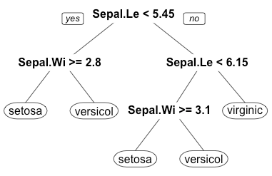
Example of a Model: A Decision Tree
Nodes: attribute-based decisions
Branches: alternative values of the attributes
Leaves: each leaf is a class
https://www.quora.com/What-are-the-disadvantages-of-using-a-decision-tree-for-classification

Slide 27
Using a Decision Tree
Given a new instance, take a path through the tree based on its attributes
When a leaf is reached, that is the class assigned to the instance
https://www.quora.com/What-are-the-disadvantages-of-using-a-decision-tree-for-classification

Slide 28
High-Level Algorithm to Learn a Decision Tree
Start with the set of all instances in the root node
Select the attribute that splits the set best and create children nodes
Eg more evenly into the subsets
When a node has all instances in the same class, make it a leaf node
Iterate until all nodes are leaves
https://www.quora.com/What-are-the-disadvantages-of-using-a-decision-tree-for-classification

Slide 29
Classifying a New Instance
Instances
Instances
Instances
Instance
Modeler
New instance
Model
Classifier
Class

Slide 30
Classifying New Instances
Instances
Instances
Instances
Instance
Modeler
New instance
Model
Classifier
Class
Class
Class
Class

Slide 31
Training and Test Sets
Instances
Instances
Training instances
(training set)
Instances
Instance
Modeler
Test instances
(test set)
New instance
Model
Classifier
Class
Class
Class
Class

Slide 32
Contamination
Instances
Instances
Training instances
(training set)
Instances
Instance
Modeler
Test instances
(test set)
New instance
Model
Classifier
When training and test sets overlap
– this should NEVER happen
Class
Class
Class
Class

Slide 33
About Classification Tasks
Classes must be disjoint, ie, each instance belongs to only one class
Classification tasks are “binary” if there are only two classes
The classification method will rarely be perfect, it will make mistakes in its classification of new instances

Slide 34
2. Building a Classifier

Slide 35
What is a Modeler?
Instances
Instances
Instances
A mathematical/algorithmic approach to generalize from instances so it can make predictions about instances that it has not seen before
Its output is called a model
Instance
Modeler
New instance
Model
Classifier
Class
Class
Class
Class

Slide 36
Types of Modelers/Models
Instances
Instances
Instances
Instance
Logistic regression
Naïve Bayes classifiers
Support vector machines (SVMs)
Decision trees
Random forests
Kernel methods
Genetic algorithms
Neural networks
Modeler
New instance
Model
Classifier
Class
Class
Class
Class

Slide 37
Explanations
Decision trees
Logistic regression
Naïve Bayes classifiers
Support vector machines (SVMs)
Random forests
Kernel methods
Genetic algorithms
Neural networks
Other models are mathematical models that are hard to explain and visualize

Slide 38
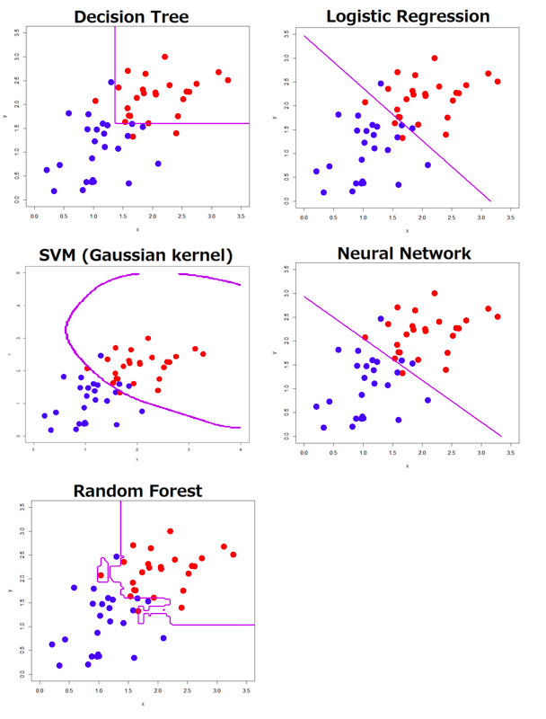
http://tjo-en.hatenablog.com/entry/2014/01/06/234155

Slide 39
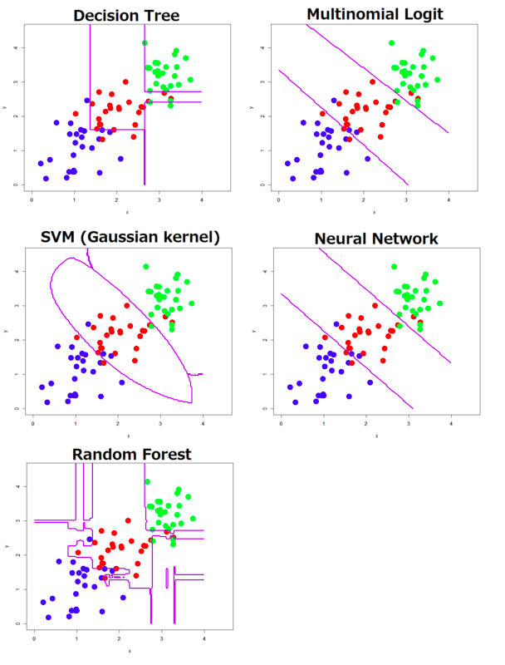
http://tjo-en.hatenablog.com/entry/2014/01/06/234155

Slide 40
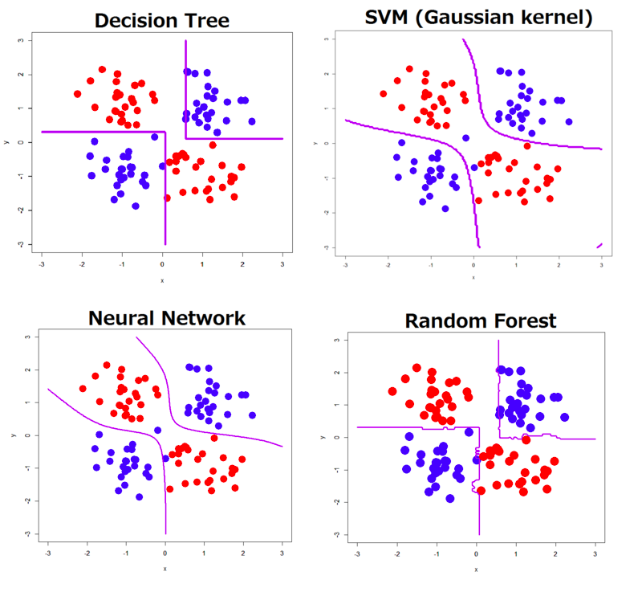
http://tjo-en.hatenablog.com/entry/2014/01/06/234155

Slide 41
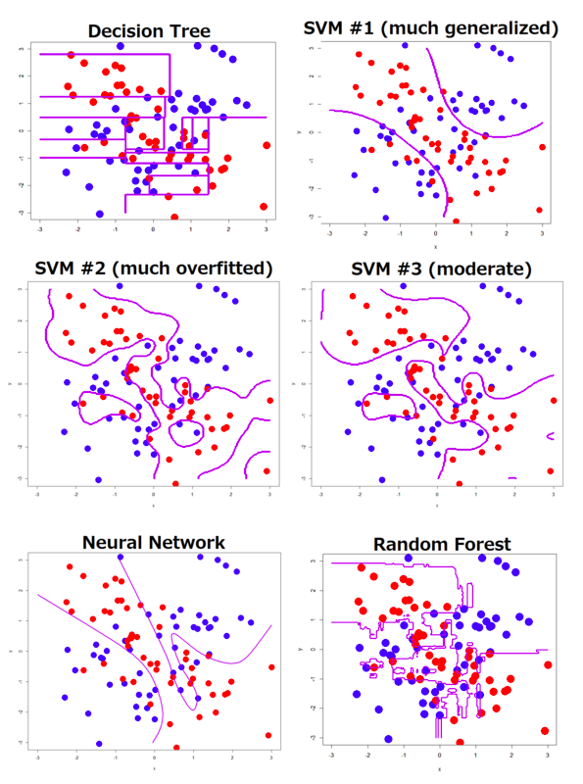
http://tjo-en.hatenablog.com/entry/2014/01/06/234155

Slide 42
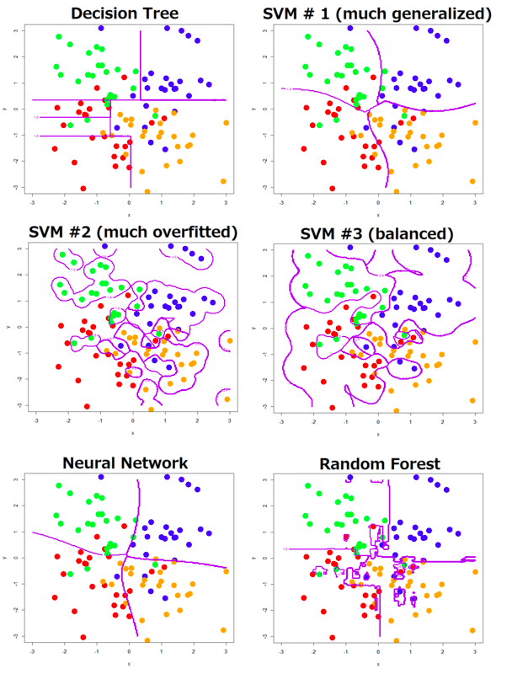
http://tjo-en.hatenablog.com/entry/2014/01/06/234155

Slide 43
What Modeler to Choose?
Logistic regression
Naïve Bayes classifiers
Support vector machines (SVMs)
Decision trees
Random forests
Kernel methods
Genetic algorithms (GAs)
Neural networks: perceptrons
Data scientists try different modelers, with different parameters, and check the accuracy to figure out which one works best for the data at hand

Slide 44
Ensembles
An ensemble method uses several algorithms that do the same task, and combines their results
“Ensemble learning”
A combination function joins the results
Majority vote: each algorithm gets a vote
Weighted voting: each algorithm’s vote has a weight
Other complex combination functions
Instances
Instances
Instances
Instance
ModelerA
ModelerB
ModelerC
ModelA
ModelB
ModelC
CombinationFunction
Final Model

Slide 45
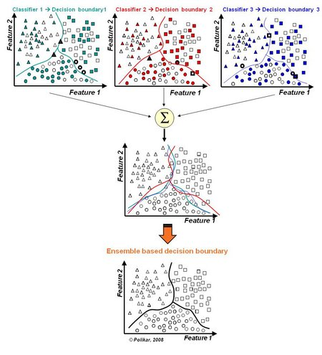
http://magizbox.com/index.php/machine-learning/ds-model-building/ensemble/

Slide 46
3. Evaluating a Classifier

Slide 47
Classification Accuracy
Accuracy: percentage of correct classifications
Total test instances classified correctly
Total number of test instances
Accuracy =

Slide 48
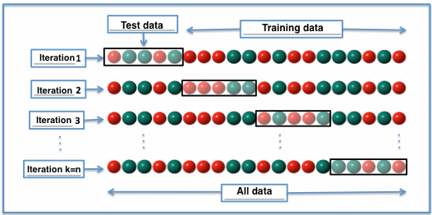
Evaluating a Classifier: n-fold Cross Validation
Suppose m labeled instances
Divide into n subsets (“folds”) of equal size
Run classifier n times, with each of the subsets as the test set
The rest (n-1) for training
Each run gives an accuracy result
Translated from image by Joan.domenech91 (Own work) [CC BY-SA 3.0 (http://creativecommons.org/licenses/by-sa/3.0)], via Wikimedia Commons (https://commons.wikimedia.org/wiki/File:K-fold_cross_validation.jpg)

Slide 49
Evaluating a Classifier: Confusion Matrix
Classified positive
Classified negative
Actual positive
True positive
False negative
Actual negative
False positive
True negative
TP: number of positive examples classified correctly
FN: number of positive examples classified incorrectly
FP: number of negative examples classified incorrectly
TN: number of negative examples classified correctly

Slide 50
Evaluating a Classifier: Precision and Recall
TP: number of positive examples classified correctly
FN: number of positive examples classified incorrectly
FP: number of negative examples classified incorrectly
TN: number of negative examples classified correctly
TP
TP
Precision =
Recall =
TP + FP
TP + FN
Note that the focus is on the positive class

Slide 51
Evaluating a Classifier: Other Metrics
There are many other accuracy metrics
F1-score
Receive Operating Characteristics (ROC) curve
Area Under the Curve (AUC)

Slide 52
Evaluating a Classifier: Other Metrics
Other accuracy metrics
F1-score
Receive Operating Characteristics (ROC) curve
Area Under the Curve (AUC)
Other concerns
Explainability of classifier results
Cost of examples
Cost of feature values
Labeling

Slide 53
Evaluating a Classifier: What Affects the Performance
Complexity of the task
Large amounts of features (high dimensionality)
Feature(s) appears very few times (sparse data)
Few instances for a complex classification task
Missing feature values for instances
Errors in attribute values for instances
Errors in the labels of training instances
Uneven availability of instances in classes

Slide 54
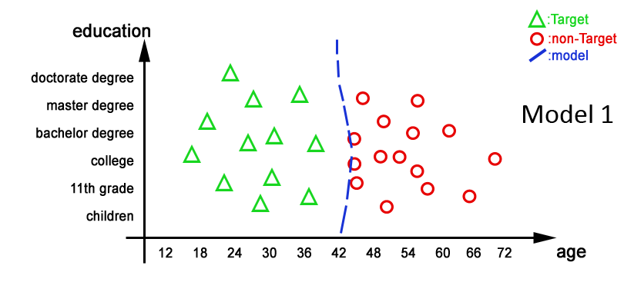
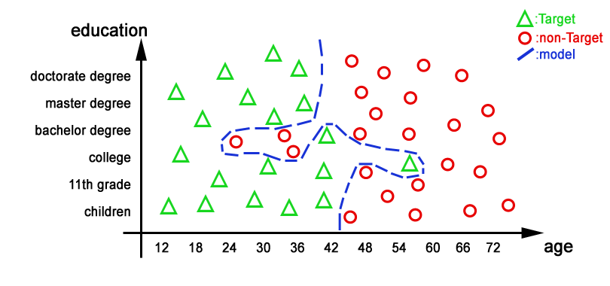
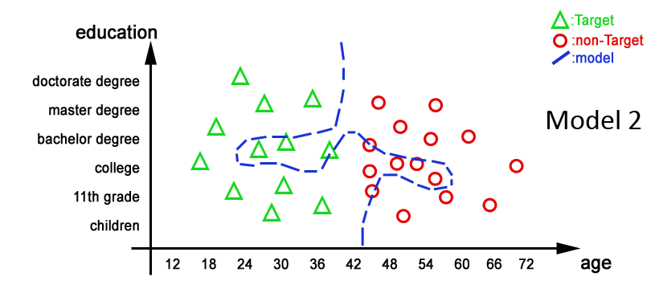
Overfitting
A model overfits the training data when it is very accurate with that data, and may not do so well with new test data
Training Data
Test Data
Model 1
Model 2

Slide 55
Induction
Induction requires inferring general rules about examples seen in the past
Contrast with deduction: inferring things that are a logical consequence of what we have seen in the past
Classifiers use induction: they generate general rules about the target classes
The rules are used to make predictions about new data
These predictions can be wrong

Slide 56
When Facing a Classification Task
What features to choose
Try defining different features
For some problems, hundreds and maybe thousands of features may be possible
Sometimes the features are not directly observable (ie, there are “latent” variables)
What classes to choose
Edible / poisonous?
Edible / poisonous / unknown?
How many labeled examples
May require a lot of work
What modeler to choose
Better to try different ones

Slide 57
Part II: Classification Summary of Topics Covered
Classification tasks
Building a classifier
Evaluating a classifier

Slide 58
Part II: Classification Summary of Major Concepts
Instances, features, values
Classes, disjoint classes
Labels, binary tasks
Learning
Decision trees
Modeler
Ensembles, combination function
Majority vote, weighted vote
Induction
Training and test sets
Evaluation
Accuracy, confusion matrix, precision & recall
N-fold cross validation
Overfitting
About the data
High dimensionality
Sparse data
Continuous/discrete values
Latent variables

Slide 59
PART III: Pattern Learning and Clustering

Slide 60
Part III: Pattern Learning and Clustering Topics
Pattern detection
Pattern learning and pattern discovery
Clustering

Slide 61
Different Data Analysis Tasks
Classification
Assign a category (ie, a class) for a new instance
Clustering
Form clusters (ie, groups) with a set of instances
Pattern discovery
Identify regularities (ie, patterns) in temporal or spatial data
Simulation
Define mathematical formulas that can generate data similar to observations collected

Slide 62
Learning Approaches
Supervised Learning
Unsupervised Learning
The training data is annotated with information to help the learning system
Eg classification
The training data is not annotated with any extra information to help the learning system
Eg pattern learning
Semi-Supervised Learning

Slide 63
1. Pattern Detection

Slide 64
Network Patterns
Subgroups
Strength of ties
Central entities
Patterns of activity over time

Slide 65
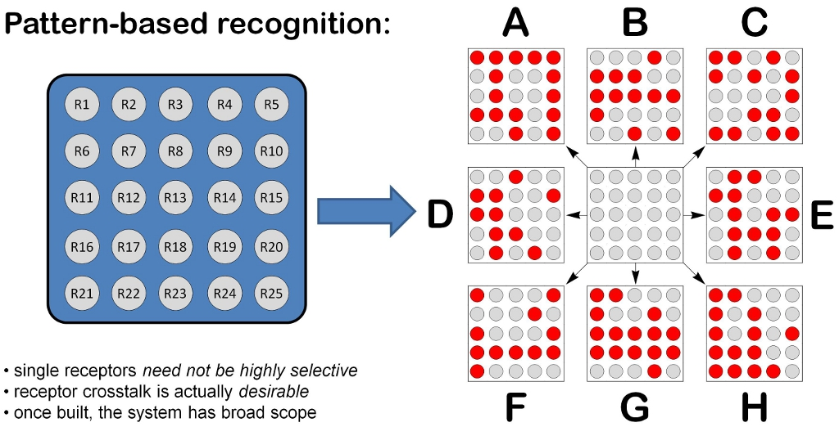
Spatial Patterns
Patterns
http://bama.ua.edu/~mbonizzoni/research.html

Slide 66
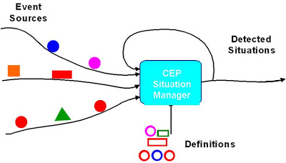
Temporal Patterns
Pattern Detector
Patterns
*
*
*
*
*
*
P1
P2
*
*
*
*
*
*
*
*
*
*
*
*
http://epthinking.blogspot.com/2009/01/on-event-pattern-detection-vs-event.html

Slide 67
Detecting Patterns in a Text String
ababababab
abcabcabcabc
abcccccccabcccabccccccccccabcabccc

Slide 68
A Pattern Language
ababababab
(ab)*
abcabcabcabc
(abc)*
abcccccccabcccabccccccccccabcabccc
((ab)(c)*)*

Slide 69
Detecting Patterns in Streaming Data
(ab)*x*
Abababthsrthwababyertueyrtyertheabsgd
abcabcabcabc
abcabcrgkskhgsnrhnabcabcabcabcrjgjsrn

Slide 70
Concept Drift
Over time, the data source changes and the concepts that were learned in the past have now changed

Slide 71
2. Pattern Learning and Pattern Discovery

Slide 72
Pattern Detection vs Pattern Learning
Pattern Detection
Pattern
Learning
Inputs:
Data
A set of patterns
Output:
Matches of the patterns to the data
Inputs:
Data annotated with a set of patterns
Output:
A set of patterns that appear in the data with some frequency

Slide 73
Pattern Detection vs Pattern Learning
Pattern Learning
Pattern Discovery
Inputs:
Data annotated with a set of patterns
Output:
A set of patterns that appear in the data with some frequency
Inputs:
Data
Output:
A set of patterns that appear in the data with some frequency

Slide 74
3. Clustering

Slide 75
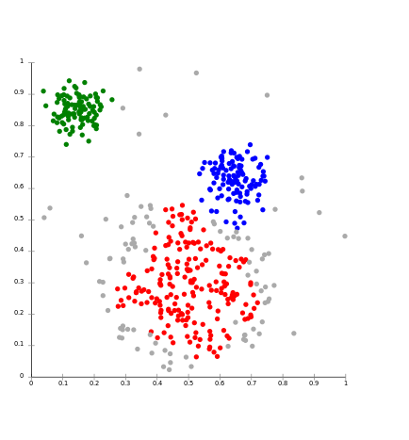
Clustering
Find patterns based on features of instances
Given:
A set of instances (datapoints), with feature values
Feature vectors
A target number of clusters (k)
Find:
The “best” assignment of instances (datapoints) to clusters
“Best”: satisfies some optimization criteria
“clusters” represent similar instances
https://commons.wikimedia.org/wiki/File:DBSCAN-Gaussian-data.svg

Slide 76
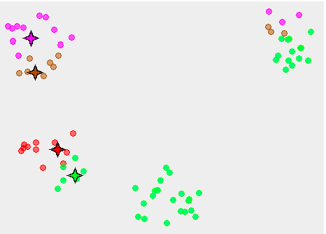
K-Means Clustering Algorithm
User specifies a target number of clusters (k)
Place randomly k cluster centers
For each datapoint, attach it to the nearest cluster center
For each center, find the centroid of all the datapoints attached to it
Turn the centroids into cluster centers
Repeat until the sum of all the datapoint distances to the cluster centers is minimized

Slide 77
K-Means Clustering (1)
https://commons.wikimedia.org/wiki/File:K-means_convergence_to_a_local_minimum.png

Slide 78
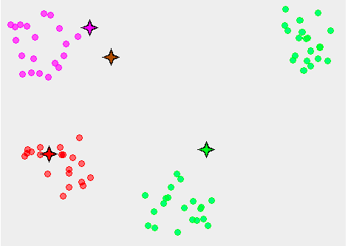
K-Means Clustering (2)
https://commons.wikimedia.org/wiki/File:K-means_convergence_to_a_local_minimum.png

Slide 79
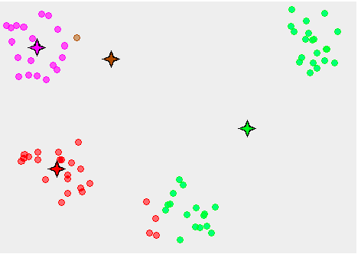
K-Means Clustering (3)
https://commons.wikimedia.org/wiki/File:K-means_convergence_to_a_local_minimum.png

Slide 80
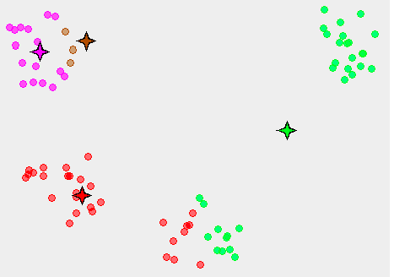
K-Means Clustering (4)
https://commons.wikimedia.org/wiki/File:K-means_convergence_to_a_local_minimum.png

Slide 81
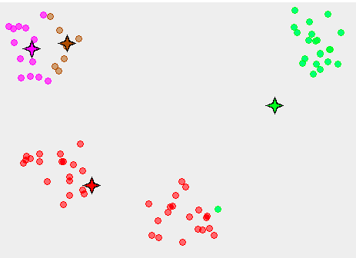
K-Means Clustering (5)
https://commons.wikimedia.org/wiki/File:K-means_convergence_to_a_local_minimum.png

Slide 82
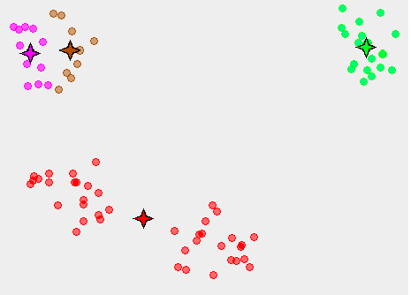
K-Means Clustering (6)
https://commons.wikimedia.org/wiki/File:K-means_convergence_to_a_local_minimum.png

Slide 83
Clustering Methods
K-Means clustering
Centroid-based
Hierarchical clustering
Attach datapoints to root points
Density-based methods
Clusters contain a minimal number of datapoints
…
https://commons.wikimedia.org/wiki/File:DBSCAN-Gaussian-data.svg

Slide 84
Part III: Pattern Learning and Clustering Summary of Topics Covered
Pattern detection
Pattern learning
Pattern discovery
Clustering

Slide 85
Part II: Pattern Learning and Clustering Summary of Major Concepts
Supervised learning, unsupervised learning, semi-supervised learning
Patterns
Pattern language
Streaming data
Concept drift
Pattern detection, pattern learning, pattern discovery
Clustering
Feature vectors
Algorithms:
K-means: cluster centers, centroids

Slide 86
PART IV: Causal Discovery

Slide 87
Today’s Topics
Correlation and causation
Causal models
Bayesian networks
Markov networks

Slide 88
1. Correlation and Causation

Slide 89
Correlation
Two variables are correlated (associated) when their values are not independent
Probabilistically speaking
Examples:
When people buy chips they are very likely to buy beer
When people have yellow fingers, they are very likely to smoke

Slide 90
Predictive Variables
Some variables are predictive variables because they are correlated with other target independent variables
Smoking and coughing are predictive variables for respiratory disease
BUT: Do predictive variables indicate the causes?
Smoking
Cough
Respiratory disease

Slide 91
Cause and Effect
Smoking
Cause
A variable v1 is a cause for variable v2 if changing v1 changes v2
Smoking is a cause for respiratory disease
A variable v3 is an effect of variable v2 if changing v3 does not change v1
Cough is an effect of respiratory disease
Respiratory disease
Effect
Cough

Slide 92
Latent Variables
Smoking
Latent variables are variables that cannot be directly observed, only inferred through a model
Eg DNA damage
Eg Carbon monoxide inhalation
Latent variables can be hard to identify, even harder to learn automatically from data
DNA
damage
Carbon
monoxide
Respiratory disease
Cough

Slide 93
Correlation vs Causation
Correlation
Causation
Knowledge of v1 provides information for v2
Eg: yellow fingers, cough, smoking, lung cancer
Can use any data collected (ie, by simple observation) and do statistical analysis
Requires being able to collect specific data that helps show causality (ie, do experiments)
Randomized controlled trial
Select 1000 people, split evenly
500 (control)
Eg forced to smoke
500 (treatment)
Eg forced not to smoke
Collect data
Association persists only when causal relation

Slide 94
2. Causal Models

Slide 95
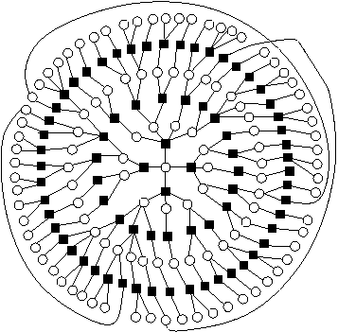
(Probabilistic) Graphical Model
Graph that captures dependencies among variables
Nodes are variables
Links indicate dependencies
Probabilities that represent how the dependencies work
http://www.eecs.berkeley.edu/~wainwrig/icml08/tutorial_icml08.html

Slide 96
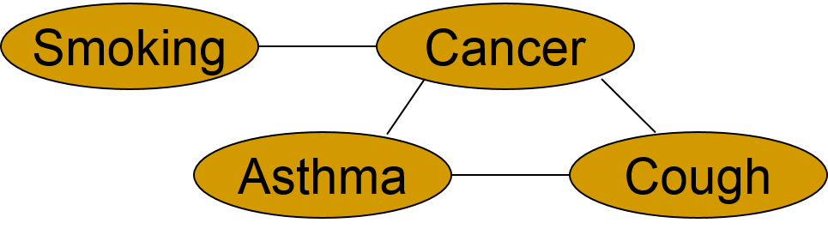
Graphical Models
Bayesian Networks
Markov Networks
Graph links have a direction
Cycles not allowed
Graph links do not have direction
Cycles are allowed
Smoking
Exposure
Respiratory disease
Cough
http://gordam.themillimetertomylens.com/

Slide 97
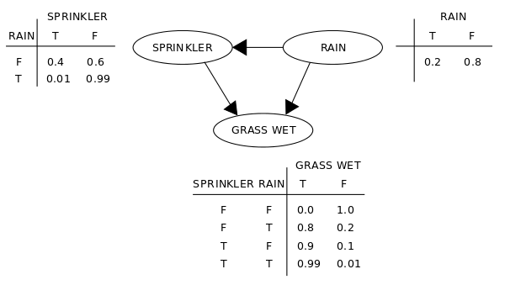
Bayesian Networks
A Bayesian network is a graph
Directed edges show how variables influence others
No cycles allowed
Conditional probability distribution (tables or functions) show the probability of the value of a variable given the values of its parent variables
A variable is only dependent on its parent variables, not on its earlier ancestors
https://en.wikipedia.org/wiki/Bayesian_network#/media/File:SimpleBayesNet.svg

Slide 98
Bayesian Inference
Bayesian inference is used to reason over a Bayesian network to determine the probabilities of some variables given some observed variables
Eg: Given that the grass is wet, what is the probability that it is raining?
https://en.wikipedia.org/wiki/Bayesian_network#/media/File:SimpleBayesNet.svg

Slide 99
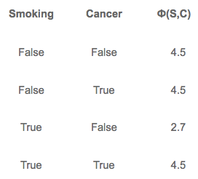
Markov Networks
A Markov network is an undirected graphical model that includes a potential function for each clique of interconnected nodes
http://gordam.themillimetertomylens.com/

Slide 100
Causal Models
A causal model is a Bayesian network where all the relationships among variables are causal
Causal models represent how independent variables have an effect on dependent variables
Causal reasoning uses the probabilities in the causal model to make inferences about the value of variables given the values of others
Eg: Given that the grass is wet, what is the probability that it rained?

Slide 101
Learning Causal Models
Parameter Learning
Structure Learning
Learning the parameters (probabilities) of the model
Learning the structure of the model
Usually more challenging

Slide 102
Part IV: Causal Discovery Summary of Topics Covered
Correlation and causation
Causal models
Bayesian networks
Markov networks

Slide 103
Part IV: Causal Discovery Summary of Major Concepts
Predictive variables
Cause and effect
Latent variables
Correlation vs causation
Randomized Control Trials
Probabilistic graphical models
Bayesian networks
Markov networks
Causal models
Parameter learning
Structure learning

Slide 104
PART V: Simulation and Modeling

Slide 105
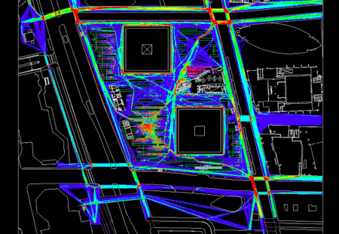
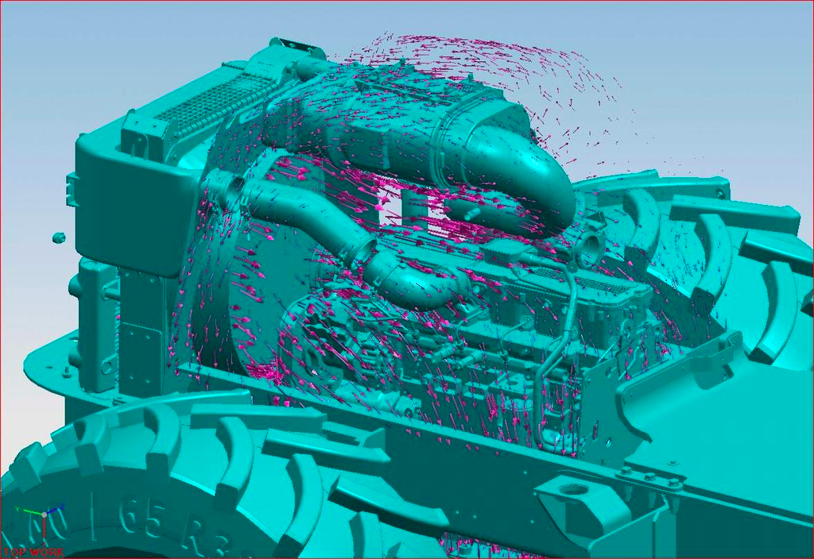
Simulation
Simulation is an approach to data analysis that uses a mathematical or formal model of a phenomenon to run different scenarios to make predictions
Eg By simulating people in a city and where they drive every day, we can analyze scenarios where there is a flu epidemic and predict people’s behavior changes
Simulation models can be improved to make predictions that correspond to the observed data
Traffic
Air flow over an engine
https://en.wikipedia.org/wiki/Traffic_simulation#/media/File:WTC_Pedestrian_Modeling.png
https://en.wikipedia.org/wiki/Simulation#/media/File:Ugs-nx-5-engine-airflow-simulation.jpg

Slide 106
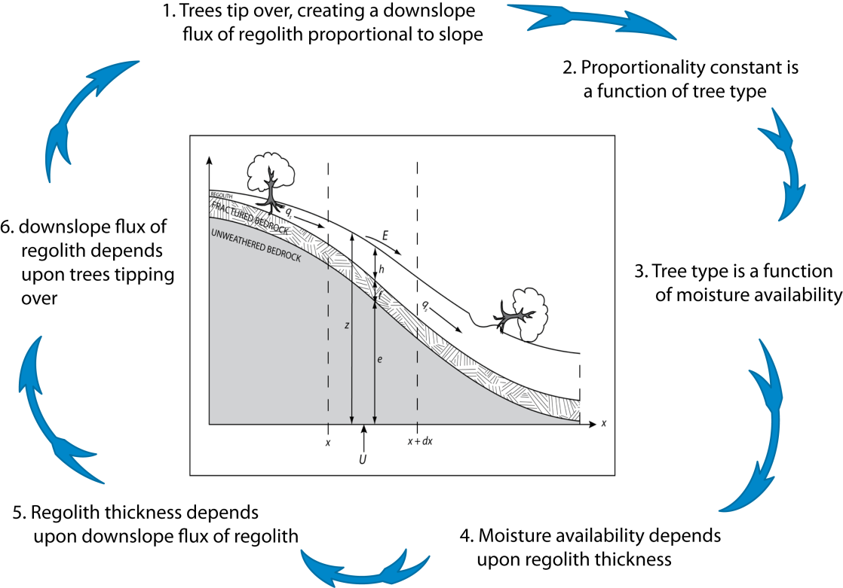
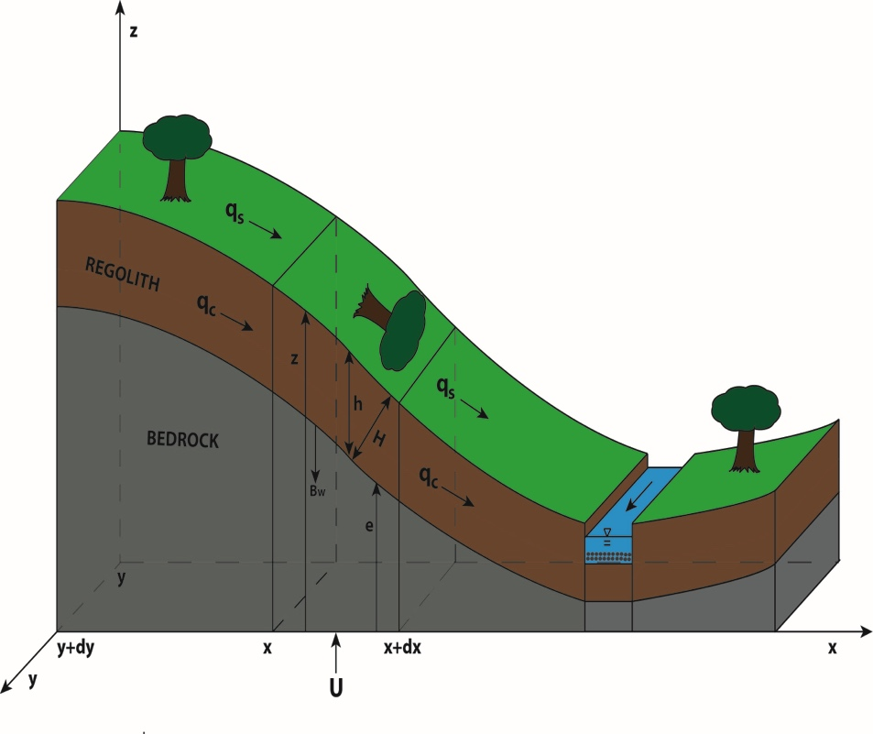
Example: Landscape Evolution
Work by Chris Duffy, Yu Zhang, and Rudy Slingerland of Penn State University
Notes:
A study of how groundwater and forest lifecycles affect the landscape.
“Redistribution of soil moisture and groundwater (<1-10 yr) affects the life cycle of trees (~100 yrs). Tree-fall introduces bio-turbation that effects macropore formation and soil movement (creep) (~100 yrs). Tectonic uplift (10³-10⁶ yrs) exposes country rocks to decay from physical and chemical weathering. Together these processes lead to the formation of regolith/soil (100’s yrs), stream networks and entire watersheds (>10⁶ yrs).”

Slide 107
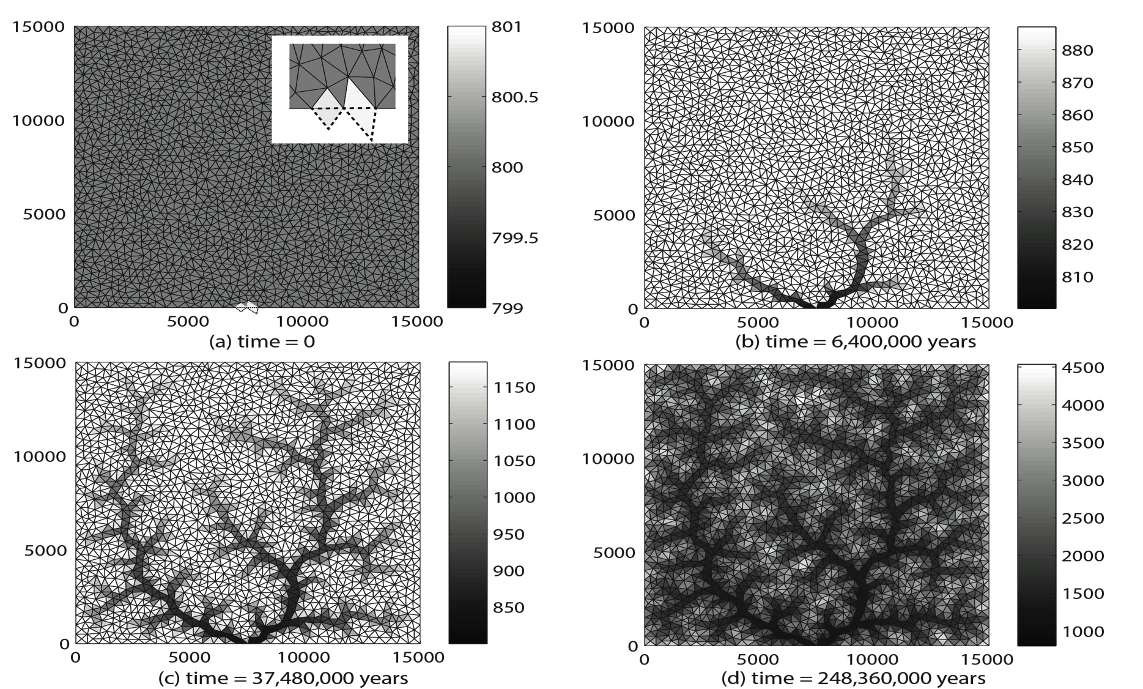
Example: Landscape Evolution
Simulated evolution of an initially uniform landscape to a complex terrain and river network over 10 ⁸ years.

Slide 108
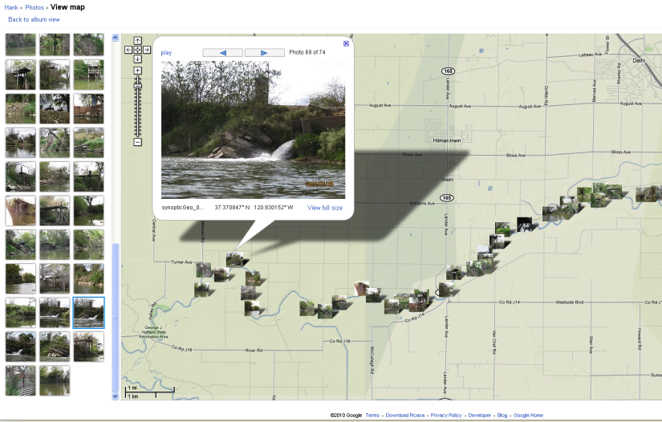
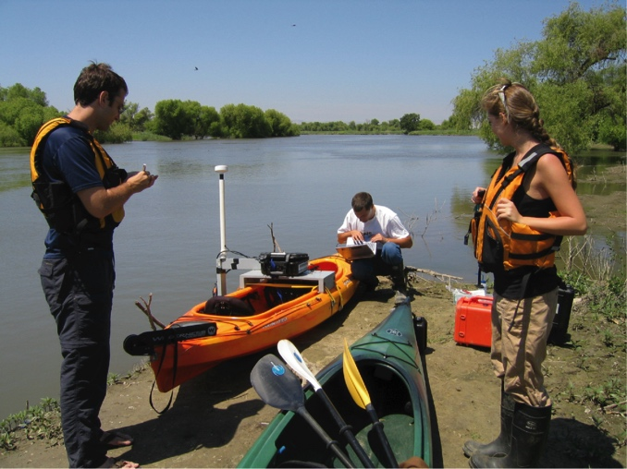
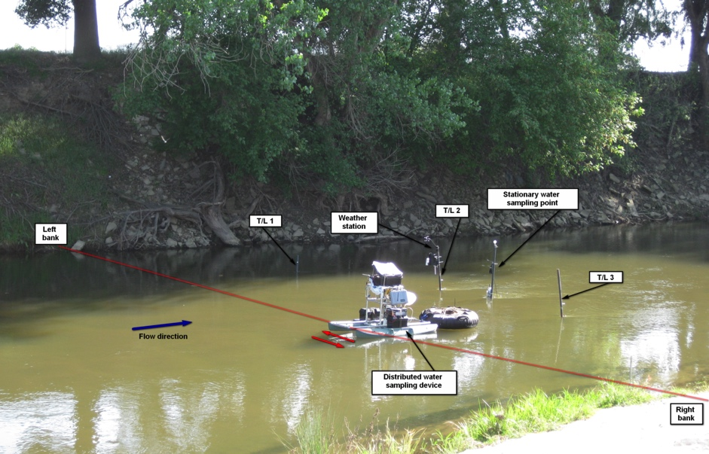
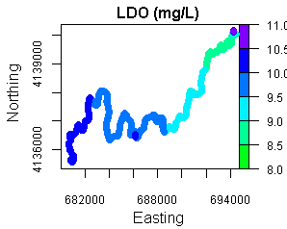


Example: Analyzing Water Quality
From T. Harmon (UC Merced/CENS)
McConnell SP
SJR confluence

Slide 109






An Example Workflow Sketch for Analyzing Environmental Data [Gil et al 2011]
California’s Central Valley:
Farming, pesticides, waste
Water releases
Restoration efforts

Slide 110

Workflow Sketch
Data
preparation
Feature
extraction
Models of how water mixes with air (“reaeration”) and what chemical reactions occur (“metabolism”)

Slide 111

From a Workflow Sketch to a Computational Workflow

Slide 112
PART VI: Practical Use of Machine Learning and Data Analysis

Slide 113
RECAP: Different Data Analysis Tasks
Classification
Assign a label (ie, a class) for a new instance given many labeled instances
Clustering
Form clusters (ie, groups) with a set of instances
Pattern learning/detection
Learn patterns (i.e., regularities) in data
Causal modeling
Learn causal (probabilistic) dependencies among variables
Simulation modeling
Define mathematical formulas that can generate data that is close to observations collected

Slide 114
RECAP: Different Data Analysis Tasks
Classification
Clustering
Pattern learning
Causal modeling
Simulation modeling
…
Each type of task is characterized by the kinds of data they require and the kinds of output they generate
Each type of task uses different algorithms

Slide 115
When Facing a Learning Task
Supervised, unsupervised, or semi-supervised: cost of labels
Setting up the learning task
Classification: What classes to choose
Clustering: How many target clusters
Causality: What observables
What data is available
Collecting data
Buying data
What features to choose
Try defining different features
For some problems, hundreds and maybe thousands of features may be possible
Sometimes the features are not directly observable (ie, there are “latent” variables)
What learning method
Better to try different ones
Scalability: processing time

Slide 116

Recent Trends: Neural Networks and “Deep Learning”
http://theanalyticsstore.ie/deep-learning/

Slide 117

Trends: Deep Learning in AlphaGo

Slide 118
Introdcuction to Machine Learning and Data Analytics: Topics Covered
Machine learning and data analysis tasks
Classification
Classification tasks
Building a classifier
Evaluating a classifier
Pattern learning and clustering
Pattern detection
Pattern learning and pattern discovery
Clustering
K-means clustering
Causal discovery
Correlation
Causation
Causal models
Bayesian networks
Markov networks
Simulation and modeling
Practical use of machine learning and data analysis

